Slide 1
Onboarding the data science team
Jeff Leek
@jtleek
www.jtleek.com

Slide 2
Initial meeting
Overview
Expectations
Policies

Slide 3

http://www.win-vector.com/blog/2012/04/setting-expectations-in-data-science-projects/

Slide 4
Human resources
Payroll
Benefits
Documentation

Slide 5

https://www.zenefits.com/

Slide 6
Introductions
Data science team
Other teams

Slide 7
Product
Marketing
Data scientist

Slide 8
Equipment and communication
Hardware
Software
Communication channels

Slide 9
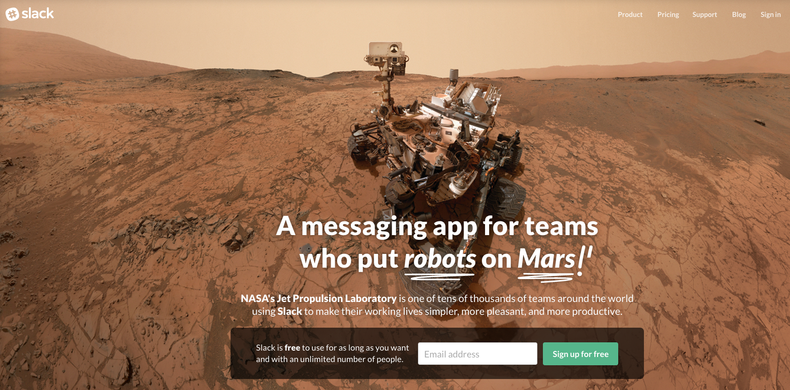
https://slack.com/

Slide 10
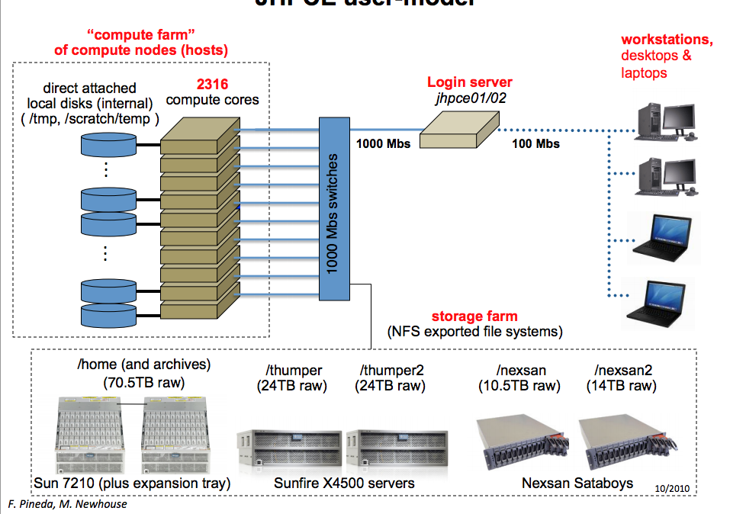
https://jhpce.jhu.edu/wp-content/uploads/2014/09/JHPCE-Overview-2014.pdf

Slide 11
Initial problem
Something to get started
Short duration
Concrete

Slide 12
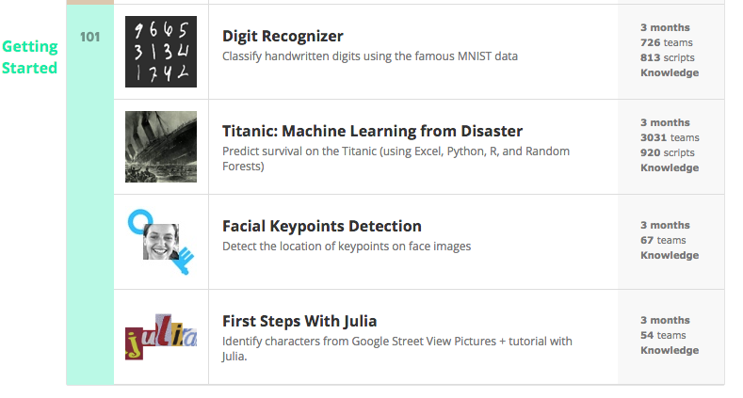
https://www.kaggle.com/competitions

